Slide 1

T-META: Trust Management for the Cold Start of IoT Services with Digital-Twin-Aided Blockchain
Presented by Chenyu Wang
2/13/2023

Slide 2

Background
Digital technologies, e.g., metaverse, are receiving increasing attention from a variety of fields.
all or parts of existing physical assets are converted to digital ones, or new things are directly created in virtual space;
A digital space of this sort 1) represents and models 3D objects 2) reveals how different assets interact with each other.

Slide 3

Innovation
These virtual interactions are conducted on diverse networks, remote sensors, and endpoint appliances, which are vulnerable to cyberattacks and threats related to asset privacy.
This research focuses primarily on privacy and trust issues in the digital space and trust solutions with the emerging technology such as blockchain, and machine learning.

Slide 4
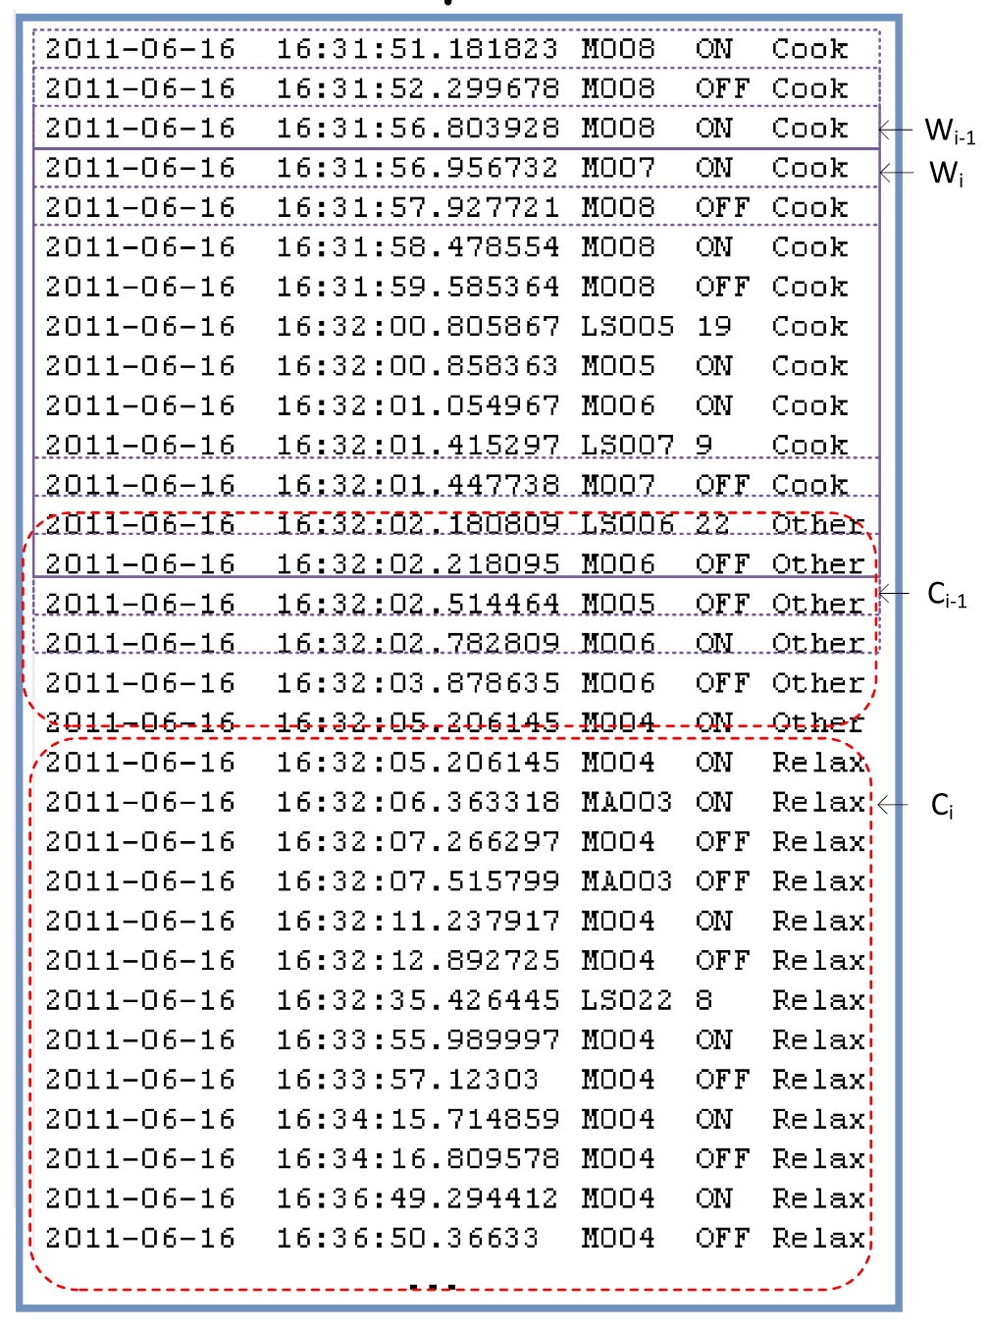
Study Case
IoT service startup
Many small-to-medium businesses are not prepared to take the plunge into IoT and utilize IoT to help their business thrive;
Example: Smart Home Real-time Activity Recognition
1. Massive Activity Labeling for Collected data (e.g., < date; time; sensorID; value >)
2. Model Training (with expensive computation cost, e.g., GPU)
Yan, Surong, et al. "Using latent knowledge to improve real-time activity recognition for smart IoT." IEEE Transactions on Knowledge and Data Engineering 32.3 (2019): 574-587.
Notes:
Case of IoT service startup

Slide 5
Study Case
Difficulties in IoT service startup
Reasons:
A limited budget to initiate the related hardware (e.g., equipment, sensors, network);
A limited understanding on the meaning behind the data, which is as the foundation IoT services.
In a word, it might be very hard for a startup company to deploy IoT services with their own data analysis and model learning under limited budget and knowledge.

Slide 6
Study Case (Cont.)
Digital twins:
intelligent and high-fidelity avatars
incorporate the financial transactions in the business and make potential decisions according to the twin intelligence
An IoT company creates digital twins of other companies to simulate their reactions based on their historical interactions.

Slide 7
Study Case (Cont.)
Challenges: Trust of Digital Twin is unknown
How an IoT startup can create high-fidelity digital twins that utilize historical transactions and bypass potential privacy strategies of knowledge source and utilize the useful information to provide IoT service.

Slide 8
Summary
We utilize the indirect trust computing method and evaluate the trust of digital twins by incorporating advice from other experts;
In the meanwhile, the digital twins maintained by the IoT startup are to accelerate the cold-start;
Finally, the cold-start business is executed based on a blockchain architecture that enables transparent data provisioning and economic knowledge obtaining.

Slide 9
Roles
IoT startup (IS): an IoT company with a limited number of historical interaction records on executed tasks is an IS, and the service it provides is a cold-start business;
Data provider (DP): When an IS provides a collected data entry to DP, DP provides the feedback about the label of this data entry.

Slide 10
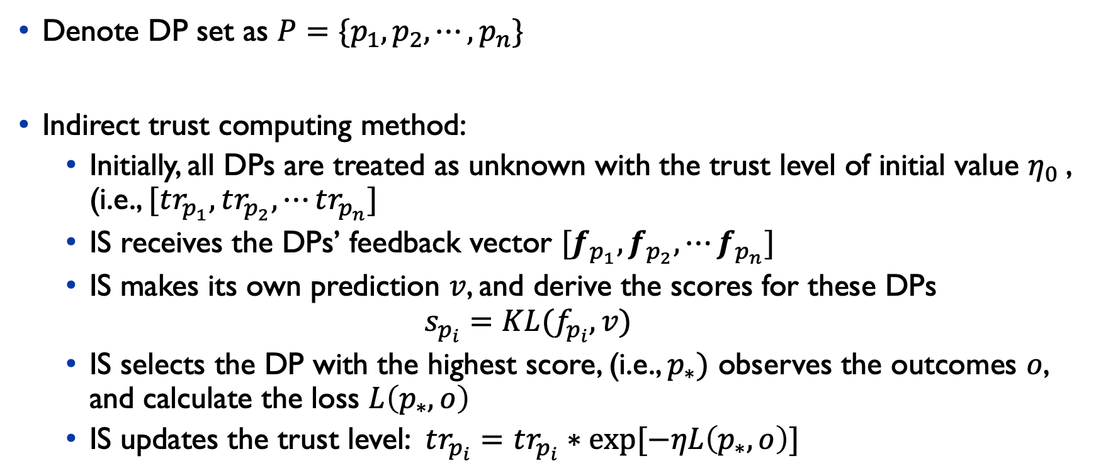
Technique – Indirect Trust
Denote DP set as $P=\{p_{1}, p_{2}, ⋯, p_{n}\}$
Indirect trust computing method:
Initially, all DPs are treated as unknown with the trust level of initial value $η_{0}$, (i.e., $[tr_{p_{1}}, tr_{p_{2}}, ⋯tr_{p_{n}}]$
IS receives the DPs’ feedback vector $[f_{p_{1}},f_{p_{2}}, ⋯f_{p_{n}}]$
IS makes its own prediction $v$, and derive the scores for these DPs
$$s_{p_{i}}=KL(f_{p_{i}}, v)$$
IS selects the DP with the highest score, (i.e., $p_{∗})$ observes the outcomes $o$, and calculate the loss $L\left(p_{∗}, o\right)$
IS updates the trust level: $tr_{p_{i}}=tr_{p_{i}}∗exp⁡[−ηL\left(p_{∗}, o\right)]$

Slide 11
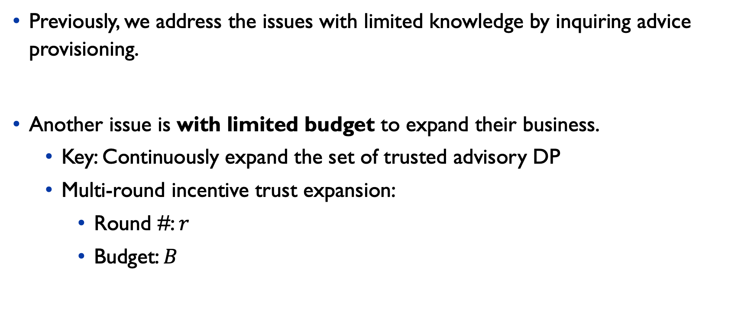
Technique – Cold Start
Previously, we address the issues with limited knowledge by inquiring advice provisioning.
Another issue is with limited budget to expand their business.
Key: Continuously expand the set of trusted advisory DP
Multi-round incentive trust expansion:
Round #: $r$
Budget: $B$

Slide 12
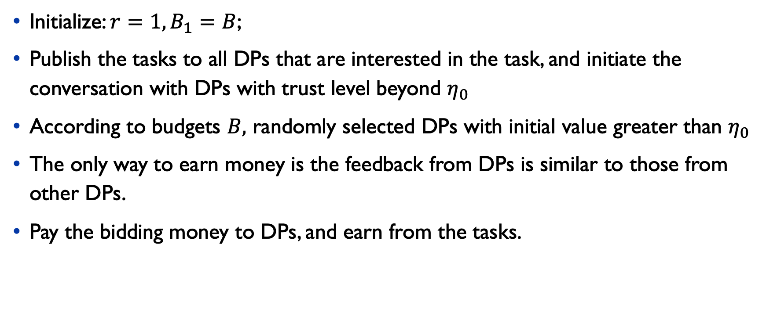
Technique – Cold Start
Initialize: $r=1, B_{1}=B$;
Publish the tasks to all DPs that are interested in the task, and initiate the conversation with DPs with trust level beyond $η_{0}$
According to budgets $B,$ randomly selected DPs with initial value greater than $η_{0}$
The only way to earn money is the feedback from DPs is similar to those from other DPs.
Pay the bidding money to DPs, and earn from the tasks.

Slide 13
Technique - Blockchain System (cont.)
The quality of advice is not guaranteed during the provision, and DP might act malicious by providing arbitrary feedback to earn the money.
A transparent, and sharable paradigm is expected to regulate the advice provision.

Slide 14
Technique - Blockchain System
IS: IoT startup
SC: Smart contract
DP: Data provider
General Process of data processing with blockchain:
1. Data Request: an IS receives a data entry and request the data processing from other DPs.
2. SC Initiation: an SC is setup that records the request proof and receive the pre-pay money from IS.
3. Data Send 1: DP sends the encrypted data, and make guarantee deposit on SC.
4. Data Confirm: IS receives the partial data and make a confirmation.
5. Data Send 2: Data owner publishes the remaining data on the blockchain.

Slide 15
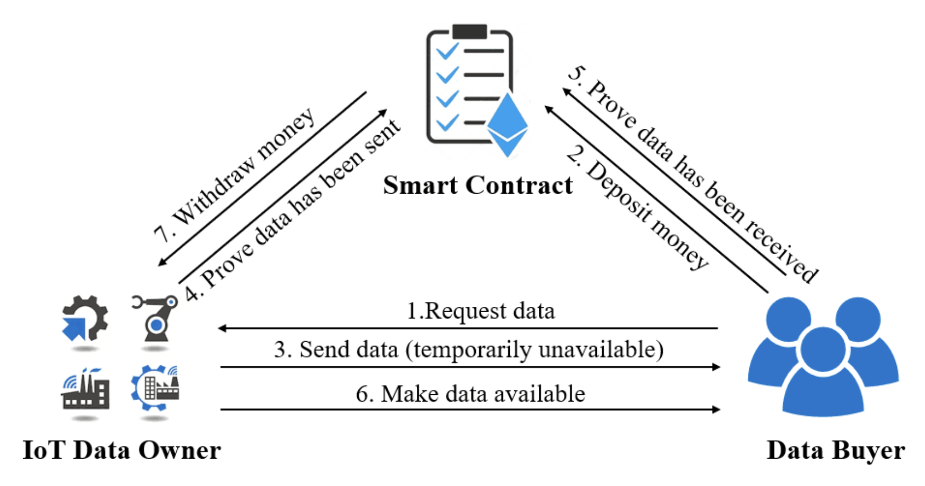
Blockchain System
Chen, Fei, et al. "Blockchain Based Non-repudiable IoT Data Trading: Simpler, Faster, and Cheaper." IEEE INFOCOM 2022-IEEE Conference on Computer Communications. IEEE, 2022.

Slide 16
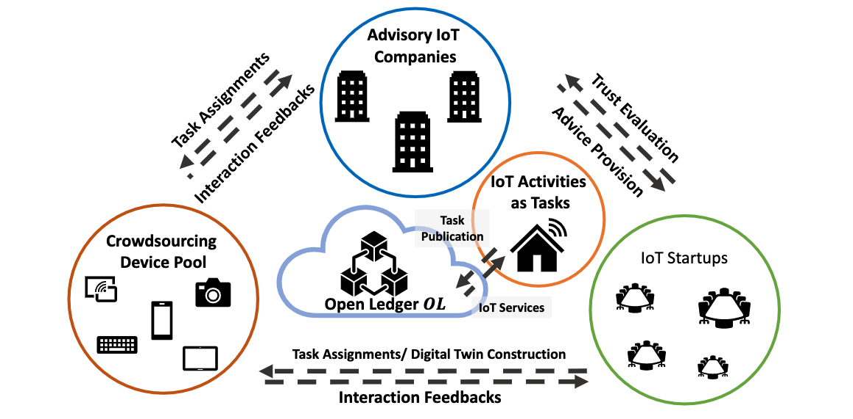
Architecture

Slide 17
Thank you!
Presented by
Chenyu Wang

